Slide 1
BRAIN TUMOR DETECTION USING DEEP LEARNING FROM SCANNED BRAIN IMAGES
PRESENTED BY,
Pooja Sree Bolisetty
Nikhil Lakkireddipalli
Kusuma Korada
START HERE

Slide 2
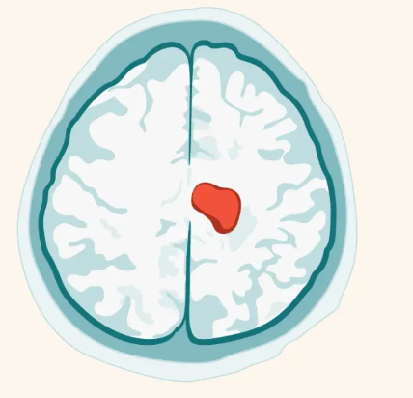
INTRODUCTION
Brain tumors are the most common solid tumor in children and adolescents, affecting about 5,000 children in the U.S. each year.
Our project focused on brain tumours, which pose a considerable risk to health and require quick diagnosis to decide the best course of treatment.
Traditional methods:
Need manual interpretation of images
Time-consuming and
Prone to errors
To overcome this issue we focused on using deep learning mainly CNN for the automated brain tumor classification

Slide 3

DATASET INFORMATION
We took the dataset from the KAGGLE
Our dataset consists two classes of:
Tumor
Healthy
Total of 4514 MRI Scanned images for
the classification task

Slide 4
DATA LOADING
Importing essential Libraries: Tensorflow, Matplotlib, glob, and modules from scikit learn and PIL
Loading the data:
Extracting the data: Loaded zip and extracted image files in specific directory
Creating Empty list : (‘image_list’) to store image data.
Reading Images: using glob (‘glob.iglob’) to iterate through image files, loading each one with PIL and converting them to NumPy arrays for processing.

Slide 5
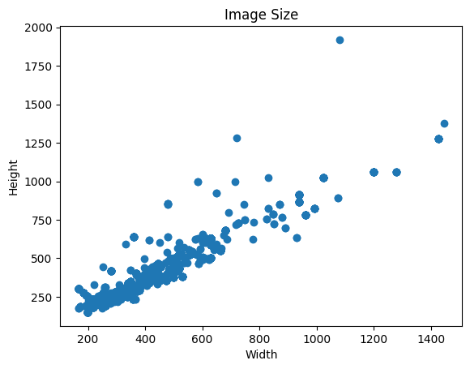
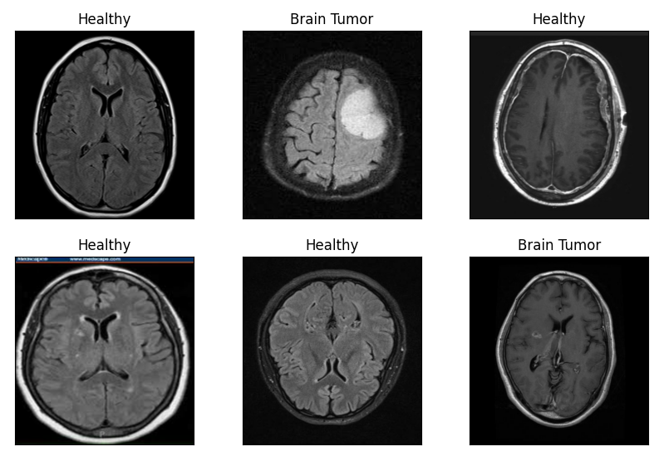
ANALYZING IMAGES
Data visualization: Calculated the average width and height of the photos to produce a standard size for resizing, ensuring that all images input into the model have the same dimensions.
Creating Datasets: Train and validation sets from the dataset
The datasets are set up to shuffle photos, break them into subsets (30% for validation), and batch them.
Images in the train dataset

Slide 6
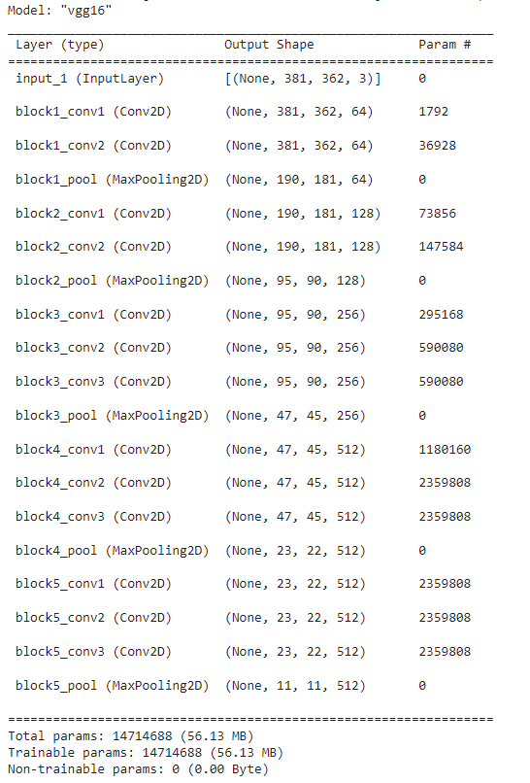

MODEL BUILDING
Model selection:
used VGG16, a pre-trained CNN from the Keras toolkit.
model is loaded without a top layer, is suited to the average dimensions of our photos, and includes pre-trained ImageNet weights.
defined a function ‘tumor_classifier’ to build a custom model based on VGG16 for tumor classification.

Slide 7
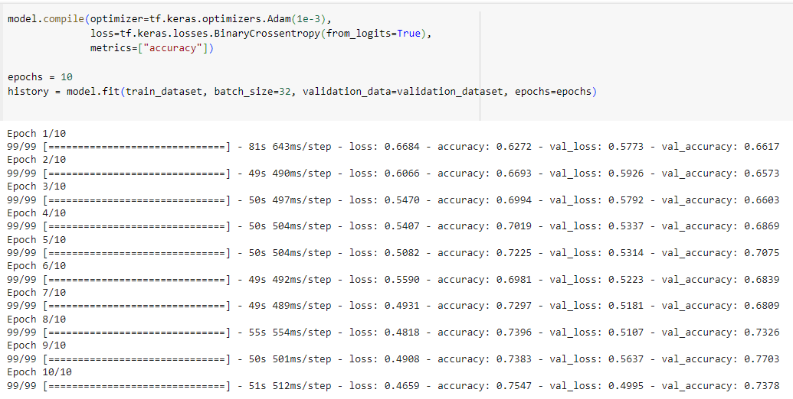
MODEL TRAINING
‘model.fit’ Method:
trains the model for a fixed number of epochs
Parameters in ‘model.fit’:
‘train_dataset’: training data is loaded
‘batch_size’: defines the number of samples used in each gradient update during training.
‘validation_data=validation_dataset’:
helps to see how well the model is generalizing to unseen data.
data on which to evaluate the loss and any model metrics at the end of each epoch.
‘epochs=10’: number of times to iterate over the training dataset.

Slide 8
MODEL SETUP AND CONSTRUCTING NEW MODEL
Load pre-trained model VGG16:
Loads model with weights pre-trained
Removed the fully connected layers of the model - adaptable to new output classes.
Set trainable layers:
The initial num_frozen_layers' weights are set to non-trainable (layer.trainable = false).
to preserve the learned generic features, while later layers can be fine-tuned to the more specifics of the new data.
New model construction:
Rescaling and preprocessing is done.
Added three convolutional layers
Pooling and flattening layer
Output layer-> dense layer-> outputs single value
No.of frozen layers is set to 7- initial convolutional layers remain unchanged- they capture the features useful for image processing.

Slide 9
Builded and trained a neural network model(new constructed model) for binary classification.
Epochs is set to 10
The accuracy obtained was low so changed the epochs to 20 to see any changes.
Increasing the epoch doesn’t show any big improvement

Slide 10
MODEL ADJUSTMENTS
Implemented data augmentation techniques like random flips and rotations and regularization to make the model robust to variations in input data.
The model is run again for 20 epochs
The validation accuracy doesn’t increase. So as the VGG16 Model has too many layers we tried building model with few layers

Slide 11
FINAL MODEL
After identifying performance issues, decide to modify the model architecture
by reducing the number of layers and
employing fewer filters in convolutional layers - to reduce overfitting and computational demand.
VGG16 contains 16 layers (13 convolutional and 3 fully linked). Has over 138 million parameters, making it computationally demanding and potentially prone to overfitting on smaller datasets.
The newly defined model (Modfinal_model) is noticeably simpler. It starts with numerous convolutional layers, then moves on to max pooling layers and eventually a dropout layer before flattening and adding dense layers. Convolutional layers use fewer filters (from 16 to 256 across layers) than VGG16, which progresses from 64 to 512.

Slide 12
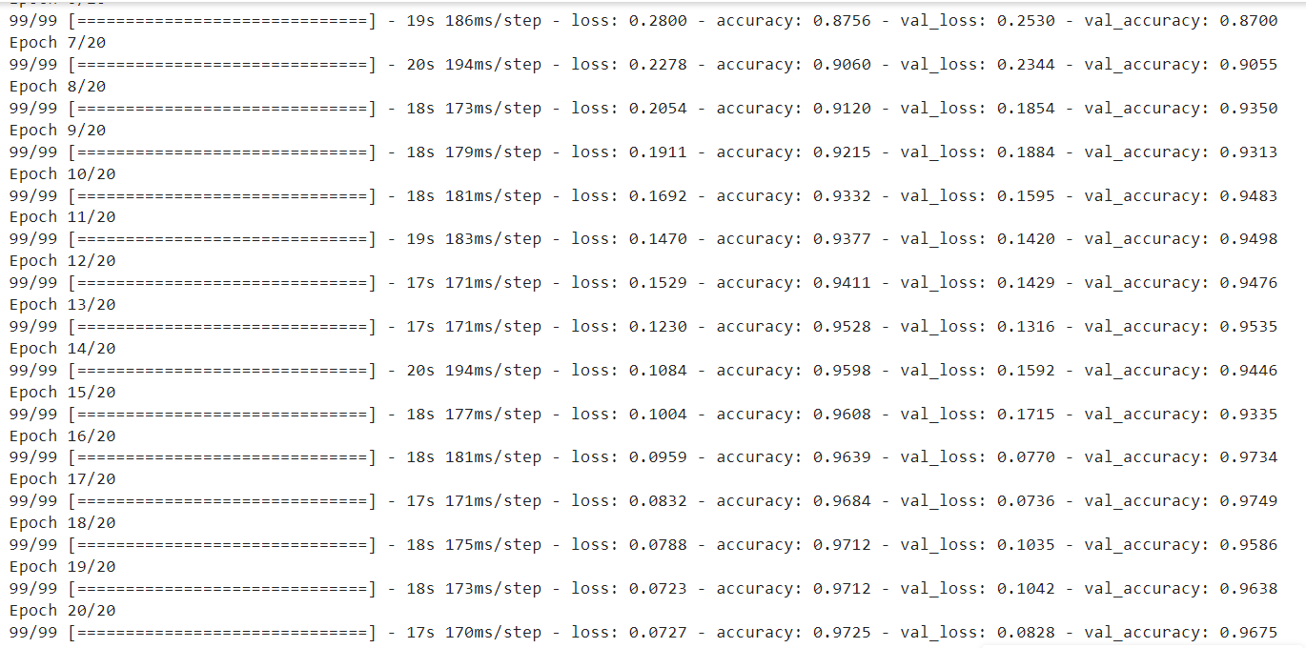
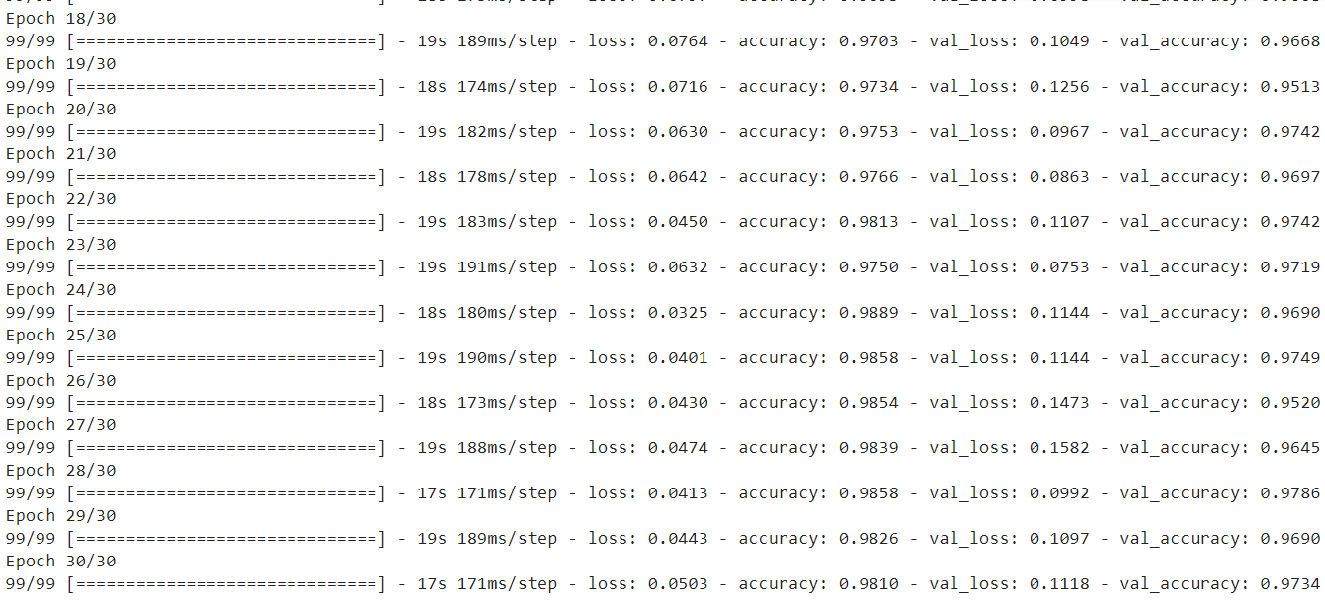
The final model was run for 20 epochs.
And seen for the accuracy
The accuracy was increased and found to be 0.967.
The final model was again run for 30 epochs. And seen for further increase in accuracy and found that the accuracy was found to be 0.9734.

Slide 13
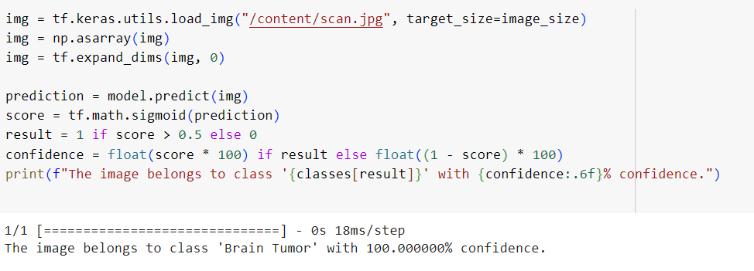
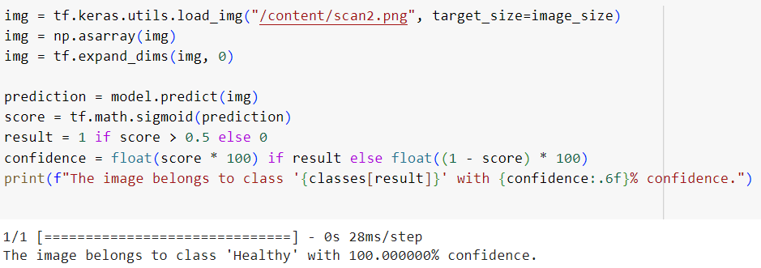
PREDICTIONS
For real-world application, we showed how to load new photos, preprocess them to meet the model's input criteria, and forecast the classes (tumor or healthy), as well as the model's confidence in its predictions.

Slide 14
INTERPRETATION FROM THE MODEL
Different models and the validation accuracies are compared
VGG16
The validation accuracy was 0.73
FINE-TUNED MODEL
By freezing the layers
The accuracy was 0.45 and 0.54 for 10 and 20 epoch respectively
DATA AUGMENTED AND REGULARIZED MODEL
No change or improvement in accuracy
Accuracy = 0.54
FINAL MODEL
Less convolutional layers
Accuracy =0.97

Slide 15
CONCLUSION
The research successfully established an exclusive convolutional neural network for the binary classification issue of detecting brain tumours in medical imaging.
The study effectively applies deep learning techniques, notably the usage of a pre-trained model(VGG16), to BRAIN TUMOR IMAGE CLASSIFICATION.

Slide 16
THANK YOU

